Slide 1
LPC1768 Timer Programming
Using delays in a software code is usual in embedded programing. A normal delay function might be used to create a period of no operation through a for loop iterating for a few 1000 cycles. But these types of delays need not be accurate and fundamentally, it is not a good programming practice. So, TIMER/COUNTER is a software designed to count the time interval between events. It counts the cycle of the peripheral clock or an externally-supplied clock.

Slide 2
LPC1768/LPC1769 has four 32-bit Timer blocks, TIMER0-TIMER3. Each Timer block can be used as a ‘Timer’ (like for e.g. triggering an interrupt every ‘t’ microseconds) or as a ‘Counter’

Slide 3
Each Timer module has its own Timer Counter (TC) and Prescale Register(PR) associated with it.
When a Timer is Reset and Enabled, the TC is set to 0 and incremented by 1 every ‘PR+1’ clock cycles – where PR is the value stored in Prescale Register. When it reaches its maximum value it gets reset to 0 and hence restarts counting.
Prescale Register is used to define the resolution of the timer. If PR is 0 then TC is incremented every 1 clock cycle of the peripheral clock. If PR=1 then TC is incremented every 2 clock cycles of peripheral clock and so on.
By setting an appropriate value in PR we can make timer increment or count : every peripheral clock cycle or 1 microsecond or 1 millisecond or 1 second and so on.

Slide 4
PC: Prescale Counter Register (32 bit) – This register increments on every PCLK(Peripheral clock).
This register controls the resolution of the timer. When PC reaches the value in PR , PC is reset back to 0 and Timer Counter is incremented by 1.
Hence if PR=0 then Timer Counter Increments on every PCLK.
If PR=9 then Timer Counter Increments on every 10th cycle of PCLK.
Hence by selecting an appropriate prescale value we can control the resolution of the timer.

Slide 5
Each Timer has four 32-bit Match Registers, MR0-MR3 and two 32-bit Capture Registers, CR0, CR1. Timer 0,1,3 have two Match outputs while Timer 2 has four.
Match Register
A Match Register is a Register which contains a specific value set by the user.
When the Timer starts – every time after TC is incremented, the value in TC is compared with match register. If it matches then it can Reset the Timer or can generate an interrupt as defined by the user.

Slide 6
Match Registers can be used to:
Stop Timer on Match(i.e when the value in count register is same as that in Match register) and trigger an optional interrupt.
Reset Timer on Match and trigger an optional interrupt.
To count continuously and trigger an interrupt on match.

Slide 7
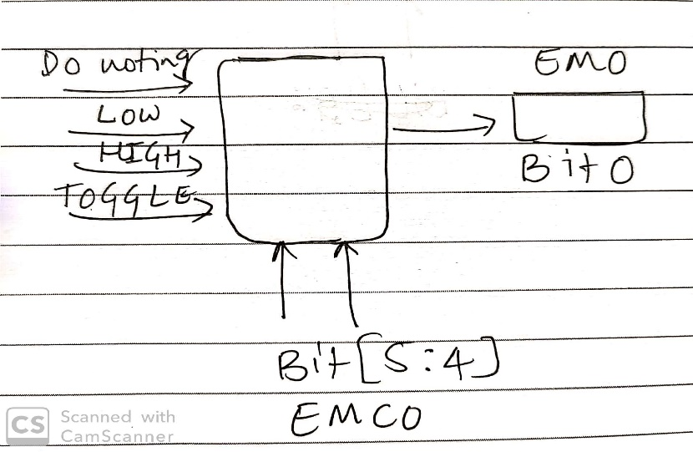
External Match Output - When a match register (MR3:0) equals the timer counter (TC) this output can either toggle, go low, go high, or do nothing.
The External Match Register (EMR) controls the functionality of this output.

Slide 8
EMR: External Match Register – It provides both status and control of External Match Output Pins. First four bits are for EM0 to EM3. Next 8 bits are for EMC0 to EMC3 in pairs of 2.
Bit 0 – EM0: External Match 0. When a match occurs between TC and MR0, depending on bits[5:4] i.e. EMC0 of this register, this bit can either toggle, go LOW, go HIGH, or do nothing. This bit is driven to MATx.0 where x=Timer number.
Similarly for Bits 1, 2 & 3.
Bits[5:4] – EMC0: External Match 0. The values in these bits select the functionality of EM0 as follows:
0x0 – Do nothing
0x1 – Clear the corresponding External Match output to 0 (MATx.m pin is LOW).
0x2 – Set the corresponding External Match output to 1 (MATx.m pin is HIGH).
0x3 – Toggle the corresponding External Match output.
Similarly for Bits[7:6] – EMC1, Bits[9,8] – EMC2, Bits[11:10] – EMC3.

Slide 9
Capture Register (CAP0-CAP3)
As the name suggests it is used to Capture Input signal. When a transition event occurs on a Capture pin, it can be used to copy the value of TC into any of the 4 Capture Register or to generate an Interrupt.

Slide 10
TCR: Timer Control Register – This register is used to enable , disable and reset TC. When bit0 is 1 timer is enabled and when 0 it is disabled. When bit1 is set to 1 TC and PC are set to zero. Rest of the bits of TCR are reserved.
CTCR: Count Control register – Used to select Timer/Counter Mode. When the value of the CTCR is set to 0x0 Timer Mode is selected.

Slide 11
MCR: Match Control register – This register is used to control which all operations can be done when the value in MR matches the value in TC. Bits 0,1,2 are for MR0 , Bits 3,4,5 for MR1 and so on.. Here is a quick table which shows the usage:
For MR0:
Bit 0: Interrupt on MR0 i.e. trigger an interrupt when MR0 matches TC. Interrupts are enabled when set to 1 and disabled when set to 0.
Bit 1: Reset on MR0. When set to 1 , TC will be reset when it matched MR0. Disabled when set to 0.
Bit 2: Stop on MR0. When set to 1 , TC & PC will stop when MR0 matches TC.
Similarly bits 3-5 , 6-8 , 9-11 are for MR1 , MR2 , MR3 respectively.

Slide 12
Setting up & configuring Timers in LPC1768
All the Registers used to program and use timers are defined as members of structure(pointer) LPC_TIMx, where x is the Timer module from 0 to 3. So for Timer0 we will use LPC_TIM0 and so on.
Registers can be accessed by de-referecing the pointer using “->” operator. For, example we can access TCR of Timer0 block as LPC_TIM0->TCR.

Slide 13
Set appropriate value in LPC_TIMx->CTCR
Define the Prescale value in LPC_TIMx->PR
Set Value(s) in Match Register(s) if required
Set appropriate value in LPC_TIMx->MCR if using Match registers / Interrupts
Reset Timer – Which resets PR and TC
Set LPC_TIMx->TCR to 0x01 to Enable the Timer when required
Reset LPC_TIMx->TCR to 0x00 to Disable the Timer when required

Slide 14
LPC1768 Timer Prescaler Calculations:
The delay or time required for 1 clock cycle when PCLK = ‘X’ Mhz is given by :
T_{PCLK} = 1/PCLK_{Hz}
=1/( X * 10⁶ )Seconds
It is also the maximum resolution Timer block can provide at a given PCLK frequency of X Mhz. The general formula for Timer resolution at X Mhz PCLK and a given value for prescale (PR) is as given below:
T_{RES} = (PR+1)/PCLK_{Hz}
=(PR+1)/(X * 10⁶ )Seconds

Slide 15
Hence, we get the Formula for Prescaler (PR) for required Timer resolution (T_{RES} in Secs) at given PCLK(in Hz) frequency as:
PR = (PCLK_{Hz} * T_{RES}) – 1
PR = ((X * 10⁶) * T_{RES}) – 1
Note that here, the resolution is also the time delay required to increment TC by 1.
Hence, Prescaler value for 1 micro-second resolution at 3 Mhz PCLK is,
PR_{1us} = (3Mhz * 1uS) -1 = (3*10⁶ * 10⁻⁶) -1 = 2
Prescaler value for 1 mili-second resolution at 3 Mhz PCLK,
PR_{1ms} = (3Mhz * 1mS) -1 = (3*10⁶ * 10⁻³) -1 = 2999

Slide 16
#define PRESCALE (3000-1)
void initTimer0(void)
{ /*Assuming that CCLK = 12Mhz and PCLK = 3Mhz.*/
LPC_TIM0->CTCR = 0x0;//Timer Mode
LPC_TIM0->PR = PRESCALE; //Increment TC at every 2999+1 clock cycles //3000 clock cycles @3Mhz = 1 mS
LPC_TIM0->TCR = 0x02; //Reset Timer, set bit1 of TCR to 1
}
void delayMS(unsigned int milliseconds) //Using Timer0
{
LPC_TIM0->TCR = 0x02; //Reset Timer, set bit1 of TCR to 1
LPC_TIM0->TCR = 0x01; //Enable timer, set bit0 of TCR to 1
while(LPC_TIM0->TC < milliseconds); //wait until timer counter reaches the desired delay LPC_TIM0->TCR = 0x00; //Disable timer, set bit0 of TCR to 0
}

Slide 17
write a program which flashes a LED every half a second.
#include <lpc17xx.h>
#define PRESCALE (3000-1) //3000 PCLK clock cycles to increment TC by 1
void delayMS(unsigned int milliseconds);
void initTimer0(void);
int main(void) {
initTimer0(); //Initialize Timer0
LPC_GPIO0->FIODIR = (1<<22); //Configure P0.22 as output
while(1) {
LPC_GPIO0->FIOSET = (1<<22); //Turn ON LED
delayMS(500); //0.5 Second(s) Delay
LPC_GPIO0->FIOCLR = (1<<22); //Turn LED OFF
delayMS(500);
}
}

Slide 18
void initTimer0(void) {
LPC_TIM0->CTCR = 0x0;
LPC_TIM0->PR = PRESCALE; //Increment LPC_TIM0->TC at every 2999+1 clock cycles //3000 clock cycles @3Mhz = 1 mS
LPC_TIM0->TCR = 0x02; //Reset Timer
}
void delayMS(unsigned int milliseconds) //Using Timer0
{
LPC_TIM0->TCR = 0x02; //Reset Timer, set bit1 of TCR to 1
LPC_TIM0->TCR = 0x01; //Enable timer, set bit0 of TCR to 1
while(LPC_TIM0->TC < milliseconds); //wait until timer counter reaches the desired delay
LPC_TIM0->TCR = 0x00; //Disable timer, set bit0 of TCR to 0
}

Slide 19
Using Match Registers
void initTimer0(void)
{
LPC_TIM0->CTCR = 0x0; //timer mode
LPC_TIM0->TCR = 0x02; //Reset Timer
LPC_TIM0->PR = 2999;
LPC_TIM0->MR0 = 500;
LPC_TIM0->MCR = 0x02; // reset TC after 500 ms delay, set bit1 of MCR to 1 (bit0-interrupt, bit2-stop)
LPC_TIM0->EMR = 0x20; // when match occurs bit0 of EMR will set to 1, set bit[5:4]=0x2 (bit[5:4]=0x1, set bit0 of EMR to LOW, bit[5:4]=0x3, Toggle bit0 of EMR)
LPC_TIM0->TCR = 0x01; //enable timer0
}
void delay(void)
{
initTimer0();
while(!(LPC_TIM0->EMR &1));
}

